Slide 1
Hands-on FHIR
Lloyd McKenzie
March 17-18, 2015

Slide 2
Introduction
Notes:
Time start-10:00 (10 minutes)

Slide 3

Who am I?
Name: Lloyd McKenzie
Company: Gevity
Background:
One of FHIR’s 3 principle editors
Co-chair FHIR Management Group
Co-chair HL7 Modeling & Methodology
Chair HL7 Canada Architecture & Infrastructure
Heavily involved in HL7 and healthcare exchange for last 15 years (v2, v3, CDA, etc.)

Slide 4
Credit where it’s due
This presentation is licensed under the Creative Commons “attribution” license (so take and use as you see fit)
A large part of the content comes from slides originally developed by Ewout Kramer (another core team member)
So significant credit (and perhaps occasionally blame? ☺) goes to him

Slide 5
Attendees
Who is your organization?
What is your role?
HL7 (v2/v3/CDA) background?
How did you hear about FHIR?
How familiar are you with FHIR?
What is the one thing that will make the next two days most valuable for you?

Slide 6
FHIR Plans
Client/Server/Both/Neither?
Type of application?
REST, Messaging, Documents, Services?
Resources of interest?
Platform of choice (.NET, Java, Ruby, …)?
Familiar with HTTP, XML, JSON, REST?
Persistence technologies used?

Slide 7
Objectives
Know how to navigate the FHIR specification and implementer resources
Be able to use FHIR in a RESTful manner
CRUD + Search
Be able to craft FHIR documents and messages
Understand FHIR architectural considerations
Be familiar with potential FHIR implementation considerations
Be ready to implement

Slide 8
Workshop structure
2 days x 4 quarters:
8:30-10:30, 11:00-12:30, 1:30-3:00, 3:30-5:30
We may adjust breaks a bit based on where we are, but will try to do lunch on time
We will try to end around 4 rather than 5:30 on Wednesday – your brains will likely be full by then ☺
Notes:
Is anyone flying out early?

Slide 9
Workshop structure (cont’d)
8 “main topics”
Ideally 1 per quarter, but some will run over, others under
We’ll adjust for interest/questions too
Each topic will end with an exercise or discussion
What’s your “take-away”?
Questions at any time, though we may defer some to after 5pm

Slide 10

Take-away
After each topic, I’ll prompt you to write down (at least) one take-away
What was the most useful thing you learned?
What do you need to watch out for in your implementation?
What do you want to investigate further?

Slide 11
Outline
Day 1
FHIR Overview
Resources
RESTful FHIR
Bundles
Day 2
Queries
Profiles & Conformance
Architecture & implementation considerations
Implementation

Slide 12
Tooling
Your favorite browser
Your favorite XML and JSON editor or:
JSON: http://www.jsoneditoronline.org/
XML: download trial version of XMLSpy or Oxygen
HTTP tool (one of)
“Chrome Poster” (Zhiping Deng)
Firefox “Poster” (Alex Milowski)
http://www.telerik.com/fiddler
Java, C#, Delphi or Objective C environment

Slide 13
FHIR Overview

Slide 14
Discussion
What are the pain-points of interoperability?
Notes:
Graphic: scraped knee?

Slide 15

Discussion
What do you hope/expect FHIR to address (and how)?

Slide 16
The acronym
F – Fast (to design & to implement)
Relative – No technology can make integration as fast as we’d like
H – Health
That’s why we’re here
I – Interoperable
Ditto
R – Resources
Building blocks – more on these to follow
Notes:
9:25

Slide 17
FHIR Manifesto
Focus on implementers
Keep common scenarios simple
Leverage existing technologies
Provide human readability
Make content freely available
Support multiple paradigms & architectures
Demonstrate best practice governance
Notes:
We don’t actually have a formal manifesto, but these are the principles we adhere to.
More stuff on implementers, common scenarios & paradigms

Slide 18
Implementer Focus
Specification is written for one target audience: implementers (that’s not just programmers)
Rationale, modeling approaches, etc. kept elsewhere
Multiple reference implementations from day 1
Publicly available test servers
Starter APIs published with spec
C#, Java, Pascal, Swift, more coming
Connectathons to verify specification approaches
Instances you can read and understand ☺
Lots of examples (and they’re valid too)
using HL7.Fhir.Instance.Model;
using HL7.Fhir.Instance.Parsers;
using HL7.Fhir.Instance.Support;
XmlReader xr = XmlReader.Create(
new StreamRead
IFhirReader r = new XmlFhirReader
// JsonTextReader jr = new JsonTe
// new StreamRead
// IFhirReader r = new JsonFhirRe
ErrorList errors = new ErrorList(
LabReport rep = (LabReport)Resour
Assert.IsTrue(errors.Count() == 0
Notes:
Spec is driven by people who write code
Numerous pieces have been changed because of experience with what worked when trying to implement
Even have a test workbench for RESTful servers

Slide 19
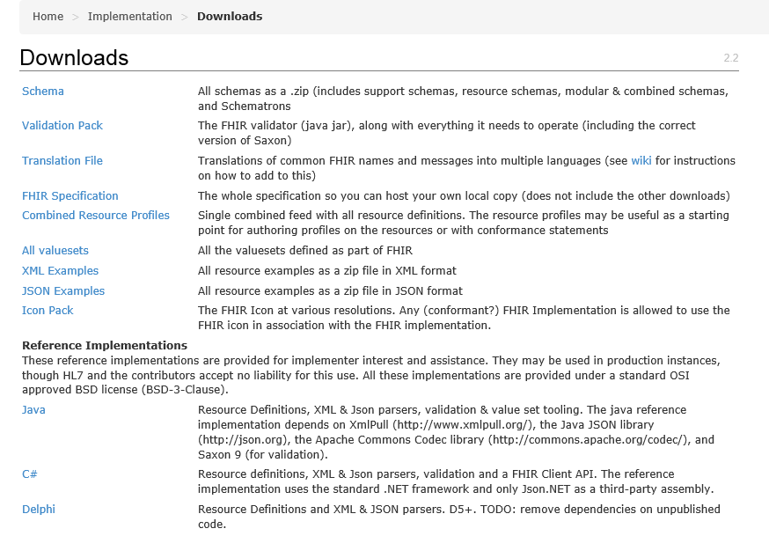
Implementer Focus is…
http://hl7.org/fhir/downloads.html
Notes:
Out-of-the box libraries for Java and C# to kickstart building clients & servers
Test servers to have someone to talk to
Community

Slide 20
Support “Common” Scenarios
80%
Inclusion of content in core specification is based on “80%” rule
Only include data elements we are confident that most (~80%) of normal implementations using that resource will make use of
Other content in extensions (more on this later)
Easy to say, governance challenge to achieve
Resources are simple and easy to understand & use
Notes:
Design by constraint failed – years to develop, what was produced required yet more design to be implementable and after that might not be interoperable
How to determine the 80%? Look to existing specs – v2, v3, CDA templates, OpenEHR, jurisdictional projects, what implementations we’ve seen
If not sure, err on the side of “not in for now”
Note: not 80% of instances, 80% of implementations
Challenges with “raising the bar”
What happens when there aren’t many/any implementations?

Slide 21
Paradigms
FHIR supports 4 interoperability paradigms
REST
Documents
Messages
Services
Notes:
Same syntax for all – improves interoperability, ability to leverage profiles

Slide 22
V2 and FHIR
Similarities
FHIR Differences
Built around re-usable “chunks” of data
Strong forward/backward compatibility rules
Extensibility mechanism
Each chunk (resource) is independently addressable
More than messages
Human readable required
Extensions don’t collide, are discoverable
Modern tools/skills
Instances easy to read
Lighter spec

Slide 23
V3 and FHIR
Similarities
FHIR Differences
Based on RIM, vocab & ISO Data types foundations
Support XML syntax
Simpler models & syntax (reference model hidden)
Friendly names
Extensibility with discovery
Easy inter-version wire compatibility
Messages, documents, etc. use same syntax
JSON syntax too
Notes:
Lower learning curve
Use the RIM in a different way

Slide 24
FHIR and CDA
Similarities
FHIR Differences
Support profiling for specific use-cases
Human readability is minimum for interoperability
APIs, validation tooling, profile tooling
(See v3 similarities on prior slide)
Can use out of the box – no templates required
Not restricted to just documents
Implementer tooling generated with spec
(See v3 differences on prior slide)

Slide 25
FHIR and Services
Similarities
FHIR differences
Encourage context neutral, re-usable structures with defined behavior
RESTful interface is a simple SOA interface
Consistent data structures across services
Ease of transport across paradigms message <-> service <-> document <-> REST
Standard framework for defining/discovering services
Notes:
FHIR allows defining additional services via the “query” mechanism as well as custom services.

Slide 26
So why use anything else?
FHIR is brand new
No market share
Not yet passed ballot
Little track record
Business case
No-one dumps existing working systems just because something new is “better”
Large projects committed to one standard won’t change direction quickly (or even at all)

Slide 27
Simple message
Yes, FHIR has the potential to supplant HL7 v3, CDA and even v2
However
It’s not going to do so any time soon
No one's going to throw away their investment in older standards to use FHIR until
The specification has a good track record
It’s clear the new thing provides significant benefits
HL7 will support existing product lines so long as the market needs them
Notes:
12:05

Slide 28
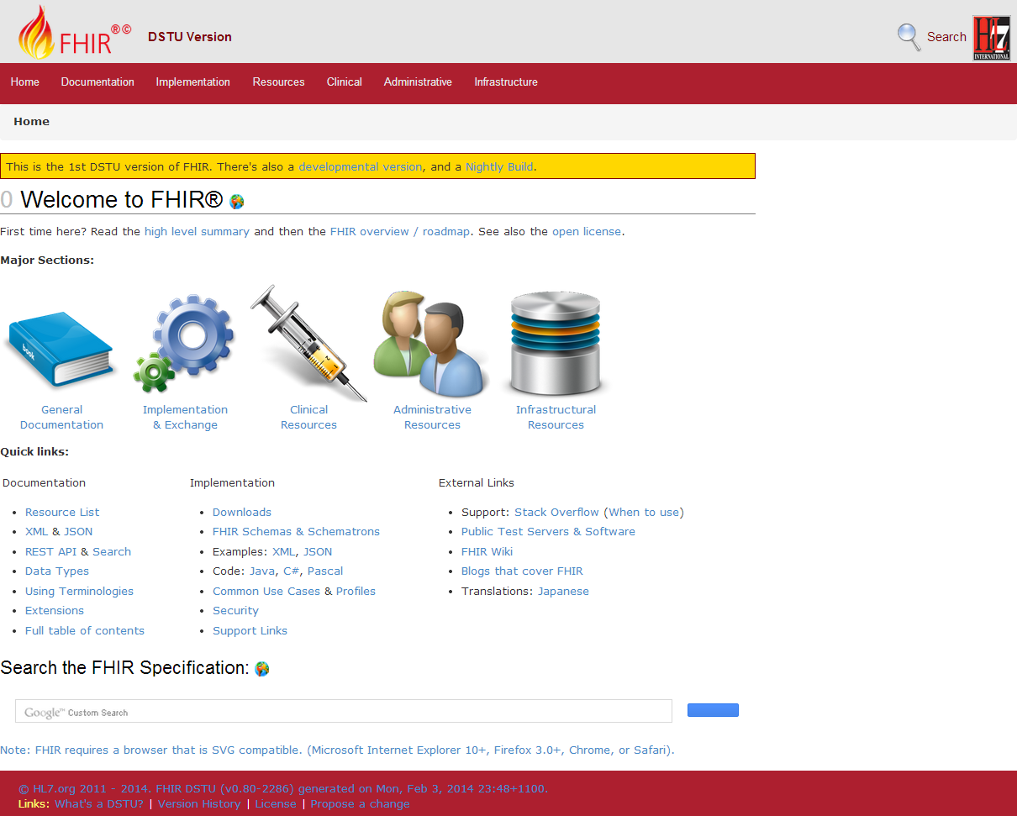
Browsing the site
Notes:
Jump to the spec. Jump around. Finish ~10am

Slide 29
Browsing the site
REST API
Data Types
XML & JSON
Codes / Terminologies
Resource List

Slide 30
The FHIR distribution
Under Implementation-Support-Downloads:
The XSD schema’s / schematrons
The Java / C# / Delphi zips (model, serializers, parsers, etc, both code & binary)
All xml + json examples
Full spec for offline reading (always have your FHIR with you)
Note! .NET implementation has moved to GitHub, distribution by NuGet (.NET) and Maven (Java)

Slide 31
The FHIR SVN
The “build” SVN tree, the “full” SVN tree
http://gforge.hl7.org/svn/fhir
User ‘anonymous’, blank password
Note: you have to run the publisher to be able to build the C# and Delphi source. Without that…they won’t compile!

Slide 32
In the FHIR SVN
All you need to build FHIR (/build)
All presentations (/presentations)
Source of the publication process (/build/tools, we use Eclipse + Java 1.6)
Archived older versions of FHIR (/archive)
You can download only the /build
Then run publish.bat & wait

Slide 33
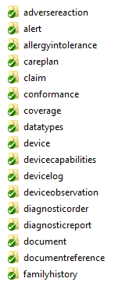
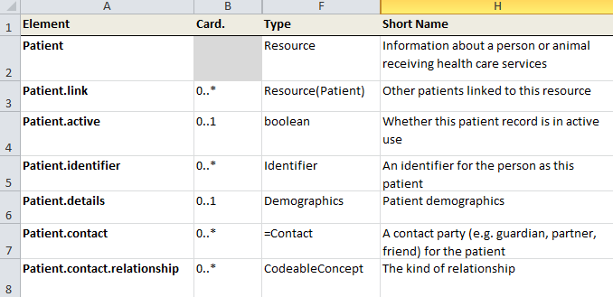
“Source” of FHIR

Slide 34


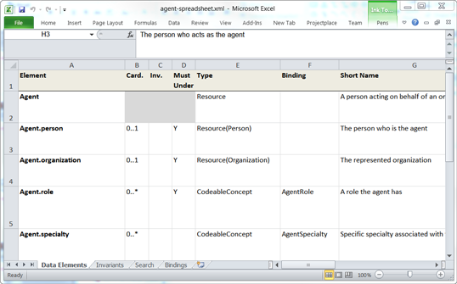


Publication process
.INI
Publication tool
(org.hl7.fhir.tools.jar)
Java, C#,
Delphi,
Objective C
Website
Examples
Resource
UML
Validation
Schema’s
DictXml
Resource profiles
eCoreDefinitions.xml

Slide 35
Generator writers!
There’s a file called eCoreDefinitions.xml that the C# generator runs of. It has all details from the definitions
There are Profiles for each resource, basically describing the “unconstrained” resources

Slide 36
Exercise #1
What resource
would you use for:
(20 minutes)

Slide 37
What resource would you use for:
Blood Pressure
Dictated sound clip
Cheek swab
Laboratory
Home visit
Problem List
Audit record
Clinical Document
Contracted taxi driver
Study subject
Record of narcotic use
Password change reminder
Group smoking cessation workshop
Females over 35
Referral
Notes:
Record individually, then discuss as a group

Slide 38
Take-away
My take-away for “FHIR Overview” is . . .
Notes:
Most useful thing you learned? What you need to watch out for in your implementation? What you want to investigate further?

Slide 39
FHIR Resources

Slide 40
Resources for developers
Where to get support:
Spec discussion threads
Implementer’s Skype chat
Stack Overflow
FHIR List server
gForge Tracker (Change requests)
FHIR User Group (AID)
FAQs (members only)
Test servers
http://wiki.hl7.org?title=FHIR

Slide 41


Resources
“Resources” are:
Small logically discrete units of exchange
Defined behavior and meaning
Known identity / location
Smallest unit of transaction
“of interest” to healthcare
V2: Sort of like Segments
V3: Sort of like CMETs
Notes:
Unit of storage / transaction: you cannot send “partial” updates

Slide 42
What is/isn’t a Resource?
Examples
Non-examples
Administrative
Patient, Location, Encounter, Organization,
Clinical Concepts
AllergyIntolerance, Questionnaire, Observation
Infrastructure
Composition, MessageHeader, Profile, Conformance
Gender
Too small
Blood Pressure
Too specific
Pregnancy
Too broad
Electronic Health Record
Too big
Notes:
And few systems will ever see more than 40-50

Slide 43
Structure of a Resource
Resource
Narrative
Metadata
Elements
Extensions
Extensions

Slide 44
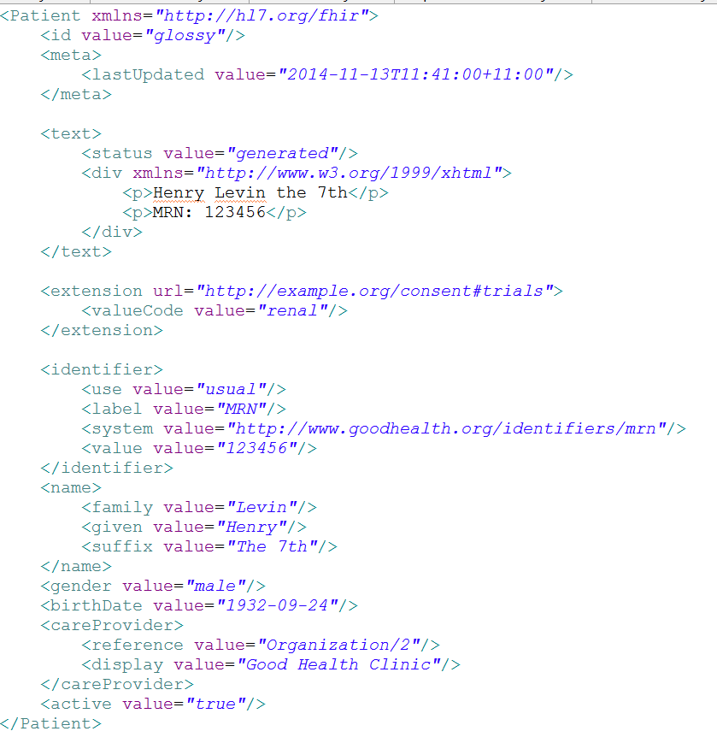
Identity & Metadata
Human Readable Summary
Extension with reference to its definition
Standard Data Content:
MRN
Name
Gender
Date of Birth
Provider
Notes:
System for gender is wrong . . .

Slide 45

Human Readable
CDA taught HL7 a very important lesson
Even if the computers don’t understand 99% of what you’re sending, that’s ok if they can properly render it to a human clinician
This doesn’t just hold for documents – important for messages, services, etc.
In FHIR, every resource should have a human-readable expression
Can be direct rendering or human entered
Notes:
Even when you think your target will understand all the encoded data, reality is data often gets shared beyond the originally intended context
Allow for exceptions for things like automated device readings, etc.

Slide 46
Resources in the spec
Let’s take a look at some Resources in the specification….
Notes:
What would people like to see? – end around 11:00
Always the same structure: intro, UML diagram, “pseudo xml”, bindings, notes, search parameters
Formal definitions, mappings
Examples!

Slide 47
Composition versus reference
FHIR makes composition and references explicit:
References are in between Resources. No context conduction across references – safe retrieval as individual resources.
Composition is within a Resource: Components have no meaning outside resource, no identity, no separate access path except through resource
Notes:
No context conduction: if a Condition resource references a particular Patient as its subject, and it links to a Procedure resource as its cause, there is no automatic rule or implication that the procedure has the same patient as its subject.

Slide 48
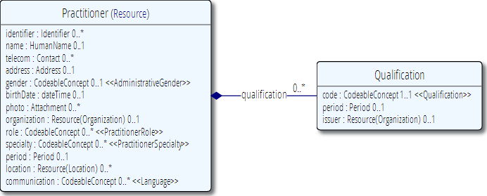
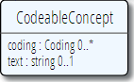
Composition of a Resource
Resource Root
Resource Component
Simple & Complex elements (may be repeating)
Notes:
Practitioner – the Resource root
Qualification is a component within Practitioner
Use of non-primitive “data types” / “value types”

Slide 49
Resource Reference
“Refers to…”
Note: No referential integrity – references are just URL’s
Notes:
References between resources are not by “business key”, it is *not* the patient id, it’s a REST URI!

Slide 50
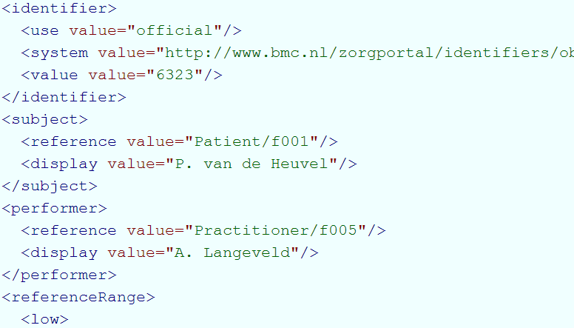
Resource Reference

Slide 51
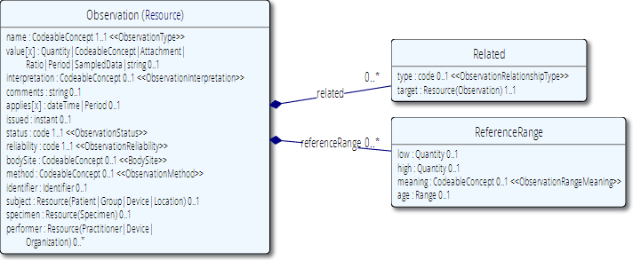
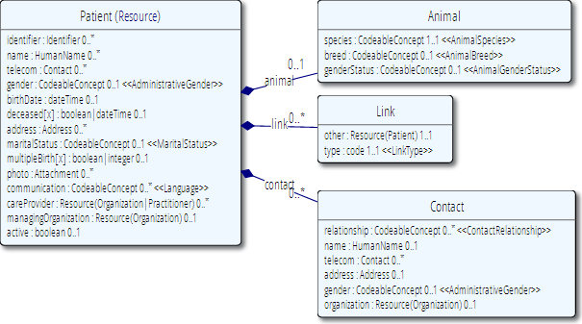
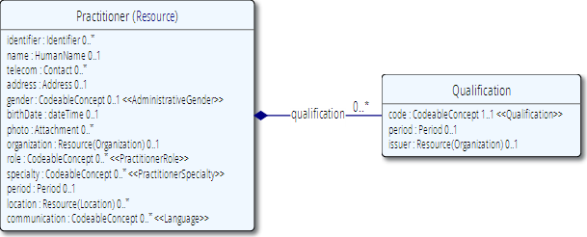
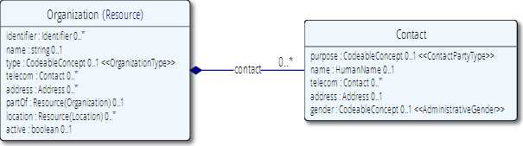
Network
subject
performer
organization

Slide 52

Resource Aggregate
“How do we know where an object
made up of other objects begins
and ends?”
“In any system with persistent storage
of data, there must be a scope for a
transaction that changes data and a way of maintaining the consistency of the data”
Notes:
Very important concept, comparable with the “Aggregate” notion of Domain Driven Design, for which many useful implementation strategies have been documented on the internet.

Slide 53
The FHIR Elements
Composite
Data Types (HumanName, Quantity, Period, Address, Identifier )
Constrained Types (Quantity: Distance, Count, Duration, Money)
use
Primitives (integer, boolean,
string, instant)
Derived Primitives
(oid, uuid, code, id)
Notes:
Only the Resources are user-definable, other types are “built-in”
Derived primitives are patterns -> validation consists of regexp matching
Constrained types are defined using invariants (OCL, Xpath, prose) -> validation using schematron, code
Narrative ONLY used in Resources
Resources can use both (derived) primitives and composite data types in its definitions
Infrastructural types need special handling, not general-purpose types

Slide 54
Start at the bottom: Primitives
boolean | xs:boolean | Values can be either true or false
integer | xs:int | A signed 32-bit integer
decimal | xs:decimal | A rational number. A true decimal, with inbuilt precision (e.g. Java BigDecimal)
base64Binary | xs:base64Binary | A stream of bytes, base64 encoded
instant | xs:dateTime | An instant in time - known at least to the second and always includes a timezone.
string | xs:string | A sequence of Unicode characters.
uri | xs:anyURI | A Uniform Resource Identifier Reference.
date | union of xs:date, xs:gYearMonth, xs:gYear | A date, or partial date as used in human communication. No time zone.
dateTime | union of xs:dateTime, xs:date, xs:gYearMonth, xs:gYear | A date, date-time or partial date as used in human communication. If hours and minutes are specified, a time zone must be populated.
Notes:
The lexical rendering for these primitives in Xml is the same as in JSON (maybe this should go in the serialization section)
Expressing the allowed values in terms of XSD primitives brings in more variability then we would like. E.g. “0” and “1” are valid for xs:boolean. “+000004”, “4”, “+4” are all valid decimals.

Slide 55
Derived primitives
Using the ISO date/time with timezone
“1951”, “1951-06” and “1951-06-04”
“1951-06-04T10:57:34.0321+01”
“1951-06-04T10:57:34.0321Z”
Notes:
TODO: Search on timestamps (lower, upper bound), converting to zulu, user-timezone, sorting of times etc.
* Old-school types built on classis logic and math from the Greek, we have new stuff too…types based on urls!

Slide 56
Derived primitives
Based on uri(!): OID and UUID
urn:oid:1.2.3.4.5
urn:uuid:a5afddf4-e880-459b-876e-e4591b0acc11
Based on string:
code (string of characters, may contain single spaces) - “4548-4”, “active”, “not known”
id ([a-z0-9\-\.]{1,36})
Notes:
TODO: Search on timestamps (lower, upper bound), converting to zulu, user-timezone, sorting of times etc.
* Old-school types built on classis logic and math from the Greek, we have new stuff too…types based on urls!

Slide 57
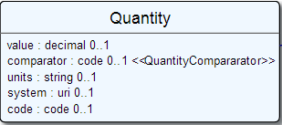
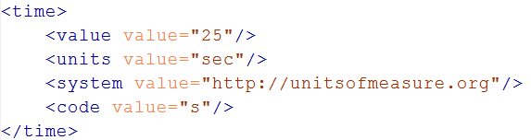
Level up: Composite Data Types
Notes:
The content of a primitive is not rendered in XML as a text node but as an attribute
Notice how the “system” of a code is now a uri, so unlike in v3 an OID is now ALSO a uri (urn:oid:1.2.3.4.5)

Slide 58
Data Types
Let’s take a look at the “Data Types” section of the FHIR specification at
http://www.hl7.org/implement/standards/fhir/datatypes.htm
Notes:
Data types use both primitives and other data types.
Some data types use attributes with cardinality > 1
Quantity has constrained variations Distance, Count, Duration, Money. They introduce constraints on useable units, but do not add attributes, so not shown here.
Note that HumanId.assigner refers to a Resource

Slide 59
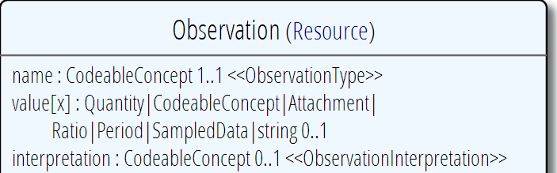
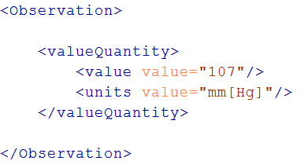
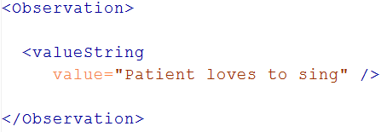
“Choice” properties
Notes:
* value[x] means: An element with a name that starts with “value”. The [x] is replaced by the (capitalized) name of the actual data type

Slide 60
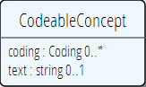
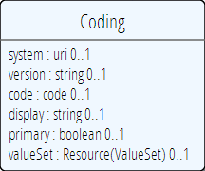
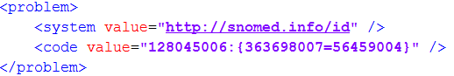
Coded types
Codes are defined in code systems
Notes:
Examples is from http://www.hl7.org/implement/standards/fhir/observation.htm
Bindings can be Incomplete (HL7 defines some codes for it, but you can add your own), Fixed (HL7 defines the only codes that are allowed) and Example (no specific codes defined, but some are given to give you an idea of what goes in the element)

Slide 61
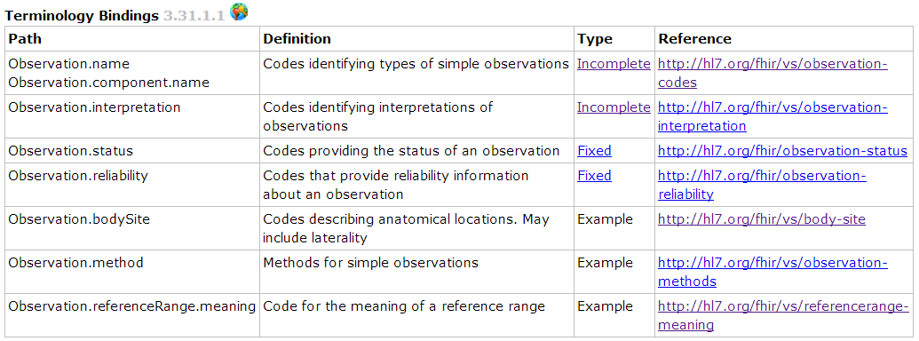
Coded types
When used in a Resource, the modelers include Bindings
Bindings specify which codes can be used
Notes:
Examples is from http://www.hl7.org/implement/standards/fhir/observation.htm
Bindings can be Incomplete (HL7 defines some codes for it, but you can add your own), Fixed (HL7 defines the only codes that are allowed) and Example (no specific codes defined, but some are given to give you an idea of what goes in the element)

Slide 62
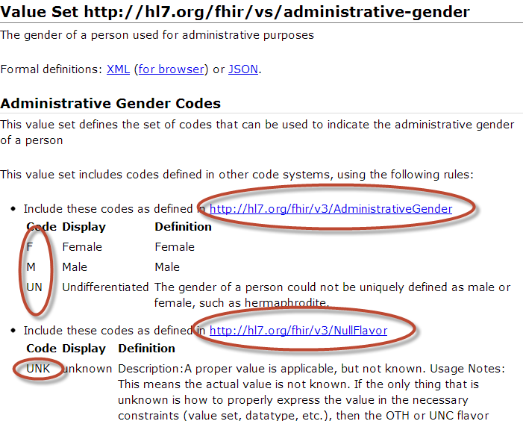
Administrative Gender value set
Notes:
Bindings use ValueSets to define what codes are allowed.
Patient.administrativeGender has a binding using the valueset “http://hl7.org/fhir/vs/administrative-gender”
This valueset includes codes from two code systems http://hl7.org/fhir/v3/AdministrativeGender and http://hl7.org/fhir/v3/NullFlavor
So yes, FHIR reused code systems from v3 (and v2), and has some defined specifically for FHIR.

Slide 63
Goto Some interesting valuesets to look at them

Slide 64
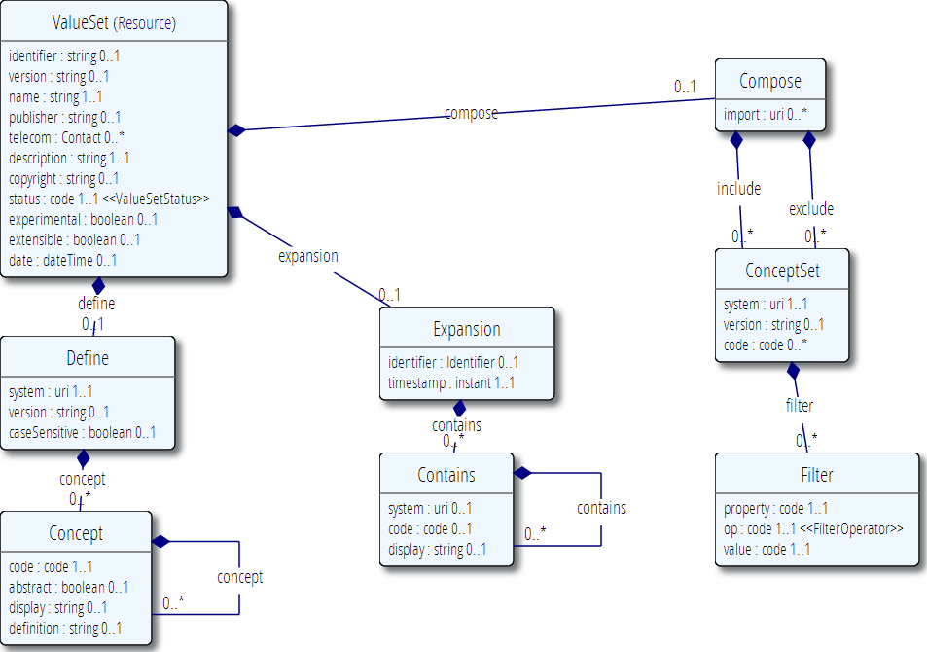
ValueSet
Publication meta-data
Concepts from 1 or more existing systems
Additional concepts

Slide 65
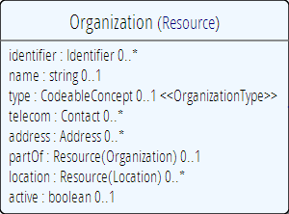
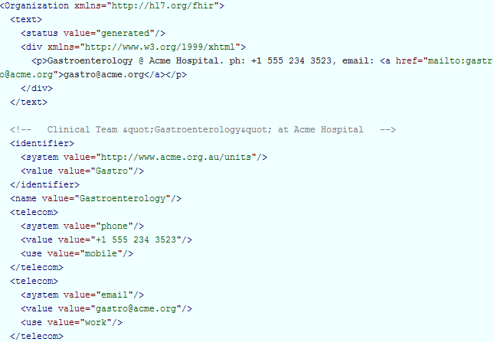
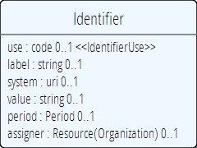
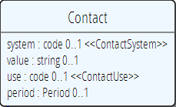
Level up: resources
Notes:
The element “identifier” is of type Identifier
The element “telecom” repeats, there is no notion of a “list” in Xml.
Empty elements are left out

Slide 66
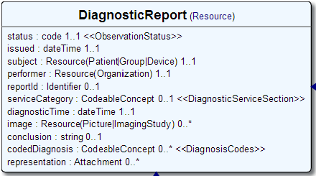
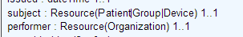
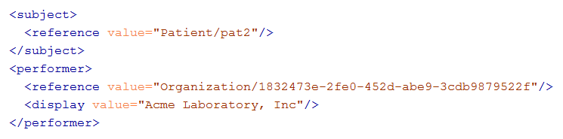
References
Notes:
There are references that can reference more than one type of resource! In this example: Resource(Patient | Group | Device)
The reference has a “type” element to indicate the kind of Resource that is referenced
References may be: Relative (on the same server), absolute URL (somewhere external) and internal (not treated here)

Slide 67
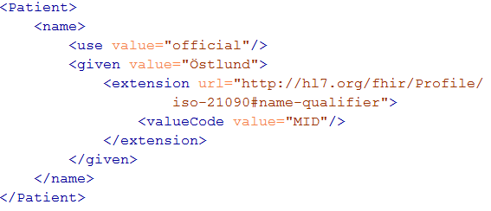
Extending a name
Key = location of formal definition
Value = value according to definition

Slide 68
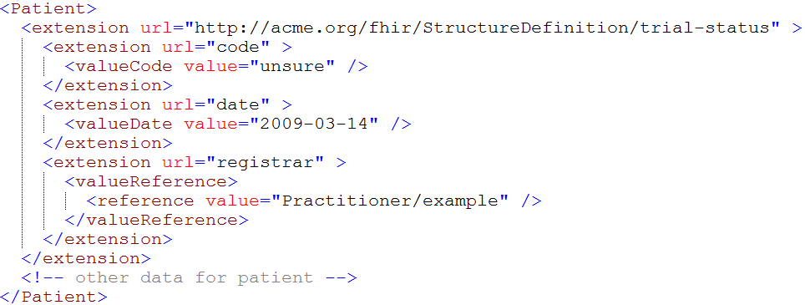
Complex extensions

Slide 69
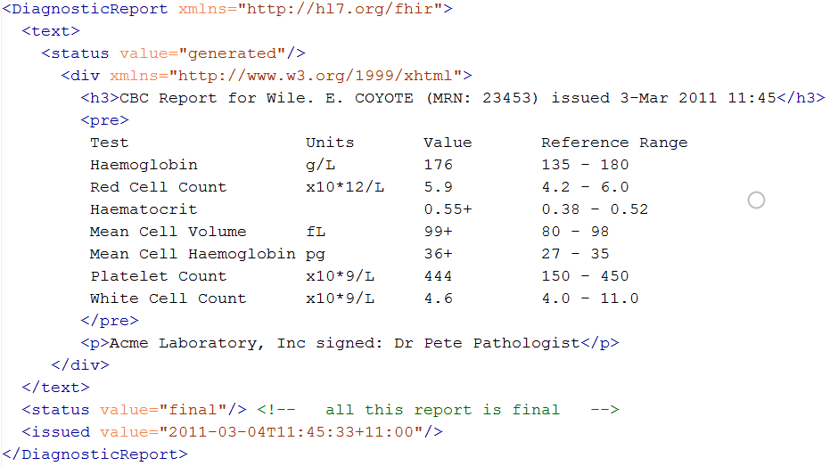
Narrative
Notes:
* “Every resource SHALL include a human readable narrative”

Slide 70
The FHIR data model (simplified!)
Composite
Data Types (HumanName, Quantity, Period, Address, Identifier )
Constrained Types (Quantity: Distance, Count, Duration, Money)
Resources
Metadata
Narrative
Elements
use
Extensions
use
Extensions
Primitives (integer, boolean,
string, instant)
use
Derived Primitives
(oid, uuid, code, id)
Notes:
Only the Resources are user-definable, other types are “built-in”
Derived primitives are patterns -> validation consists of regexp matching
Constrained types are defined using invariants (OCL, Xpath, prose) -> validation using schematron, code
Narrative is ONLY used in Resources
Resources can use both (derived) primitives and composite data types in its definitions
Infrastructural types need special handling, not general-purpose types

Slide 71
Exercise #2
Build a resource . . .
(30 minutes)

Slide 72
Create a patient
Following data:
Donald Duck, male, born June 9, 1934
1 407-939-6244, d.duck@disney.com
SSN: 123 456 789
Next of kin: Daisy
Other elements as you see fit
Bonus points:
Primary physician: Patricia Primary
Include a picture
XML & JSON

Slide 73
Exercise Review
Did everyone include narrative?
Anyone include species?
How did you handle “next of kin”? Primary physician?
Did you put spaces in your SSN?
Notes:
Next of Kin = contact
Physician = contained resource

Slide 74
Take-away
My take-away for “FHIR Resources” is . . .
Notes:
Most useful thing you learned? What you need to watch out for in your implementation? What you want to investigate further?

Slide 75
RESTful FHIR

Slide 76
REST?
“REpresentational State Transfer”
Represent your data as “resources”
Make “Resources” URI addressable
Use HTTP to do CRUD operations
Resources may be exchanged using different representations

Slide 77
Why REST?
Loose coupling
Servers & clients can evolve independently
Simple, fixed API
Stateless – simplifies coding
Id = URI makes distributed architecture easy
Leverages web technology stack
TLS, OAuth, etc.
Scales well (the whole internet)

Slide 78
Caveats with REST
REST isn’t ideal for every use-case
Doesn’t handle transactions well
Orchestration is handled by client
requires server trusts client to do what’s needed
Security (authorization) model is still maturing
Can be verbose when manipulating lots of records
Remember that REST is a FHIR option, not a requirement

Slide 79
Just a quick GET
GET /fhir/Patient/1 HTTP/1.1
HTTP/1.1 200 OK
Content-Type: application/xml+fhir;charset=utf-8
Content-Length: 787
Content-Location:
http://fhir.furore.com/fhir/Patient/1/_history/1
Last-Modified: Tue, 29 May 2012 23:45:32 GMT
HTTP Verb + path
UTF-8 encoded
<?xml version="1.0" encoding="UTF-8"?>
<Patient xmlns="http://hl7.org/fhir"><identifier><label>SSN</label><identifier><system>
http://hl7.org/fhir/sid/usssn</system><id>444222222</id></identifier></identifier><name><use>official</use><family>Everywoman</family><given>Eve</given></name><telecom><system>phone</system><value>555-555 2003</value><use>work</use></telecom><gender><system>http://hl7.org/fhir/sid/v2-0001</system>
<code>F</code></gender><birthDate>1973-05-31</birthDate><address><use>home</use><line>2222 Home Street</line></address><text><status>generated</status><div xmlns="http://www.w3.org/1999/xhtml">Everywoman, Eve. SSN:444222222</div></text></Patient>
See the BOM?
Notes:
You can retrieve any person using a GET on the person’s id, which is just an url on the server: /fhir/person/@<id>
We have our own MIME-type: “text/xml+fhir”
Note that FHIR always uses UTF-8. Since this is not the default for HTTP, the server explicitly mentions this
But should mean the xml encoding mentions “utf-8” and that the payload is really encoded in utf-8
There can be a Byte Order Mark, but hopefully your framework handles all that ;-)
The response returns a Content-Location header with a version-specific location….see next slide

Slide 80
A Resource’s identity
In fact: a URL
https://server.org/fhir/Patient/1
resource type
endpoint
identifier
Note: This URL resolves to the current version of a resource
Notes:
This is not only the URL you use to retrieve the resource, it’s also its id.
All URLs in FHIR are case-sensitive (and so is the id)
It is *metadata*, you won’t find this in the Resource’s definition

Slide 81
Resource metadata
Patient
MRN 22234
“Ewout Kramer”
30-11-1972
Amsterdam
REST Identities
http://fhir.hl7.org/Patient/23E455A3B
http://fhir.hl7.org/Patient/23E455A3B/_history/4
Last updated
2013-12-23T23:33:01+01:00
Tag: http://example.org/fhir/Status#Test
Profile: http://hl7.org/fhir/Profile/us-core

Slide 82
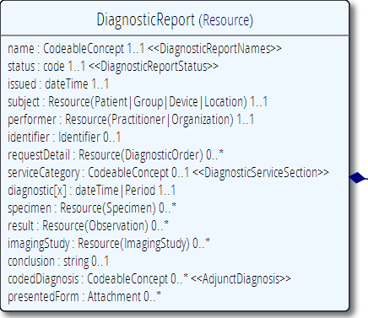
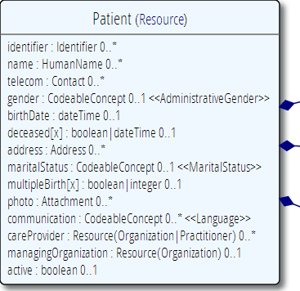
“Business” identifiers
Notes:
Resource Id’s (=URLs) are infrastructural id’s, they differ from “business” identifier.
Many Resources also have business identifiers, they are explicitly modeled, like Patient.identifier (even more than one identifier possible!)
Business identifiers are completely separate from technical resource id’s

Slide 83
One more look at the header
GET /fhir/Patient/1 HTTP/1.1
HTTP/1.1 200 OK
Content-Type: application/xml+fhir;charset=utf-8
Content-Length: 787
Content-Location: http://fhir.furore.com/fhir/Patient/1/_history/12
Last-Modified: Tue, 29 May 2012 23:45:32 GMT
Notes:
You can retrieve any person using a GET on the person’s id, which is just an url on the server: /fhir/person/@<id>
We have our own MIME-type: “text/xml+fhir”
Note that FHIR always uses UTF-8. Since this is not the default for HTTP, the server explicitly mentions this
But should mean the xml encoding mentions “utf-8” and that the payload is really encoded in utf-8
There can be a Byte Order Mark, but hopefully your framework handles all that ;-)
The response returns a Content-Location header with a version-specific location….see next slide

Slide 84
For a specific version…
We have the version-specific URL
https://server.org/fhir/ (continued)
Patient/1/_history/4
base path
resource type
identifier
version id
Notes:
Both the Resource id URL and the version-specific URL are used on many places of the REST spec and resource content (References!). They are always used consistently in this form.

Slide 85
Support for versions
33, v12 – 2012-12-04
/server.org/fhir/Patient/33/_history/12
33, v13 – 2012-12-05
/server.org/fhir/Patient/33/_history/13
33, v14 – 2012-12-08
/server.org/fhir/Patient/33/_history/14
33, v15 – 2012-12-09
/server.org/fhir/Patient/33/_history/15
/server.org/fhir/Patient/33
Notes:
* Note that you have two ways (at one moment) to reach version 15

Slide 86
REST “representations”
GET /fhir/Patient/1?_format=json HTTP/1.1
HTTP/1.1 200 OK
Content-Type: application/json+fhir;charset=utf-8
Content-Length: 787
GET /fhir/Patient/1 HTTP/1.1
Accept: application/json+fhir
HTTP/1.1 200 OK
Content-Type: application/json+fhir;charset=utf-8
Content-Length: 787
Notes:
You can retrieve any person using a GET on the person’s id, which is just an url on the server: /fhir/person/@<id>
We have our own MIME-type: “text/xml+fhir”
Note that FHIR always uses UTF-8. Since this is not the default for HTTP, the server explicitly mentions this
But should mean the xml encoding mentions “utf-8” and that the payload is really encoded in utf-8
There can be a Byte Order Mark, but hopefully your framework handles all that ;-)
The response returns a Content-Location header with a version-specific location….see next slide

Slide 87
Question
DO I REALLY HAVE TO IMPLEMENT VERSIONS?
DO I REALLY NEED TO SUPPORT THAT PRE-HISTORIC XML STUFF?
NO, You are not required to keep history, and may return 410 (Gone) on a “vread” for any request for an older version than the current one!

Slide 88
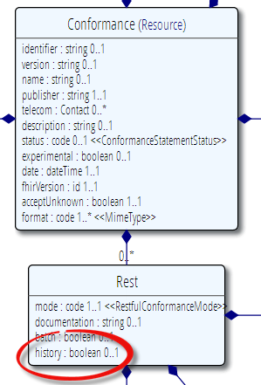
Remember conformance?
Which FHIR version?
Which Resources?
What search operations?
What formats?
Is this a test server?
Who can I contact?
What’s the name of the software?
DO YOU SUPPORT HISTORY?
DO YOU SUPPORT XML/JSON?
http://www.hl7.org/fhir/conformance.htm

Slide 89
Tag metadata
GET /fhir/Patient/1 HTTP/1.1
HTTP/1.1 200 OK
Content-Location: http://sever.om/fhir/Patient/1/_history/12
Last-Modified: Tue, 29 May 2012 23:45:32 GMT
Category: http://example.org/fhir/Status#Test; scheme=" http://hl7.org/fhir/tag"; label="Our test tag"
http://hl7.org/fhir/tag | A general tag
http://hl7.org/fhir/tag/profile | A profile tag - a claim that the Resource conforms to the profile identified in the term
http://hl7.org/fhir/tag/security | A security label
Notes:
You can retrieve any person using a GET on the person’s id, which is just an url on the server: /fhir/person/@<id>
We have our own MIME-type: “text/xml+fhir”
Note that FHIR always uses UTF-8. Since this is not the default for HTTP, the server explicitly mentions this
But should mean the xml encoding mentions “utf-8” and that the payload is really encoded in utf-8
There can be a Byte Order Mark, but hopefully your framework handles all that ;-)
The response returns a Content-Location header with a version-specific location….see next slide

Slide 90
Mapping (meta)data to HTTP
Resource data
Resource id
Resource version
Last update date
Tags
http body
Url
Content-Location header
Last-Modified header
Category header
Notes:
Should be ~2:30pm

Slide 91
REST in the spec
Let’s look at these operations in the specification….

Slide 92
Mapping to verbs
create 2.1.10
The create interaction creates a new resource in a server assigned location. The create interaction is performed by an HTTP POST operation as shown:
POST [service-url]/[resourcetype] (?_format=mimeType)
read 2.1.6
The read interaction accesses the current contents of a resource. The interaction is performed by an HTTP GET operation as shown:
GET [service-url]/[resourcetype]/{id} (?_format=mimeType)
update 2.1.8
The update interaction creates a new current version for an existing resource or creates a new resource if no resource already exists for the given id. The update interaction is performed by an HTTP PUT operation as shown:
PUT [service-url]/[resourcetype]/{id} (?_format=mimeType)
delete 2.1.9
The delete interaction removes an existing resource. The interaction is performed by an HTTP DELETE operation as shown:
DELETE [service-url]/[resourcetype]/{id}

Slide 93
To create a resource
You POST the contents to an url which indicates the resource type:
E.g. https://server.org/fhir/Patient
Supply body’s format in Content-Type header
Server returns 201 (Created).
Returns only the newly assigned version id URL in the Location header.

Slide 94
To update a resource
Use PUT on the resource’s URL, with the new contents in the body
Tell server the body’s format (xml/json) in the Content-Type header
Server returns 200 and the URL to new version in the Content-Location header.

Slide 95
Using PUT to create
Server might/might not allow you to PUT to an id that does not yet exist.
If it does: Resource gets created at that location ➔ client determines resource’s id!
If it does not: server returns 501 (Not implemented)
Notes:
- Whether server allows this depends on the level of trust between server and client: e.g. in-house scenario versus nation-wide network.

Slide 96
Version-aware updates
Server requires client to send Content-Location header with a version-specific URL
Server uses this to check whether you are updating the latest version.
Server will then return 409 (Conflict) if it has been updated by someone else in the meantime
Notes:
Behaviour depends on server configuration (and made public in a conformance statement).

Slide 97
What’s a ‘deleted’ Resource?
Trying read operations will return in a 410 (Gone) result in stead of 404 (Not Found)
The resource will not be returned by the search operation.
You can “undelete” by doing an update with fresh content
Just a “marker” in a resource’s history
Notes:
* the deletion operation should be understood as deleting the record of the resource, with nothing about the state of the real-world corresponding resource implied.

Slide 98
Version history - deletions
33, v12 – 2012-12-04
/server.org/fhir/Patient/33/_history/12
33, v13 – 2012-12-05
/server.org/fhir/Patient/33/_history/13
33, v14 – 2012-12-08
/server.org/fhir/Patient/33/_history/14
33, v15 – 2012-12-09
/server.org/fhir/Patient/33/_history/15
33, v16 – 2012-12-10
DELETION
/server.org/fhir/Patient/33/_history/16
/server.org/fhir/Patient/33
Notes:
* Now, if you query for /server.org/fhir/patient/@33, you get a 410

Slide 99
Version history - revival
33, v13 – 2012-12-05
/server.org/fhir/Patient/33/_history/13
33, v14 – 2012-12-08
/server.org/fhir/Patient/33/_history/14
33, v15 – 2012-12-09
/server.org/fhir/Patient/33/_history/15
33, v16 – 2012-12-10
/server.org/fhir/Patient/33/_history/16
33, v17 – 2012-12-11
/server.org/fhir/Patient/33/_history/17
/server.org/fhir/Patient/33
Notes:
* The resource returns back to life!

Slide 100
The Binary Endpoint
https://someserver/fhir/Binary/
Accepts any kind of content
Stores the content as is, along with the content type provided by the HTTP headers.
Acts just like the normal Resource endpoints (but there is no search, narrative, etc.)

Slide 101
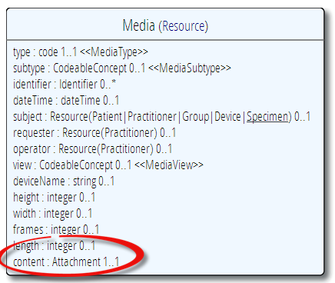
Useful for Attachments
/Binary/23344

Slide 102
Using FHIR Client in C#
var client = new FhirClient(
new Uri("https://fhir.com/svc/fhir"));
var patEntry = client.Read<Patient>("1");
var pat = patEntry.Resource;
var restId = patEntry.Id;
var tags = patEntry.Tags;
pat.Name.Add(HumanName.ForFamily("Kramer")
.WithGiven("Ewout"));
client.Update<Patient>(patEntry);

Slide 103
Validation
When receiving an XML resource
1. Validate using schema
2. Run schematrons
When receiving JSON
1. Parse the JSON
2. Serialize to XML
3. Validate using schema
4. Run schematrons
There’s a validation pack for Java

Slide 104
Exercise #3
Some RESTful exercise . . .
(30 minutes)

Slide 105
RESTful operations
Using your HTTP submission tool + the instance you created before
Create the instance (using PUT or POST)
Update the instance
Delete the instance
Retrieve history
Bonus points
Set and remove a tag
Try updating a historical version
Notes:
How many Donald Ducks do we have now? – no constraint on duplicates unless you implement a business rule

Slide 106
Take-away
My take-away for “RESTful FHIR” is . . .
Notes:
Most useful thing you learned? What you need to watch out for in your implementation? What you want to investigate further?

Slide 107
FHIR Bundles
Messages, Documents, Transactions and More!

Slide 108
Communicating lists
We need to communicate lists of Resources
Search result
History
Documents or messages
Multiple-resource inserts (“transactions”)
So, we need an industry-standard to represent lists, and a place to put our metadata

Slide 109
Mapping (meta)data to HTTP
?
Which industry-standard can represent lists of resources, including our “metadata”:
Resource data
Resource id
Resource version
Last update date
http body
Url
Content-Location header
Last-Modified header

Slide 110
Bundles
Atom RFC 4287 + Tombstones RFC 6721
Poll-based protocol for keeping up-to-date with newsfeeds (RSS and Atom)
You can “subscribe” to a FHIR feed and get updates -> pub/sub scenario’s
Almost any platform has API’s for Atom
Alas, no standard “atom for json”
Notes:
- In our previous section on REST we saw how we mapped this metadata to HTTP headers, but in a query result, we need to find a way to map this to a list, Atom

Slide 111
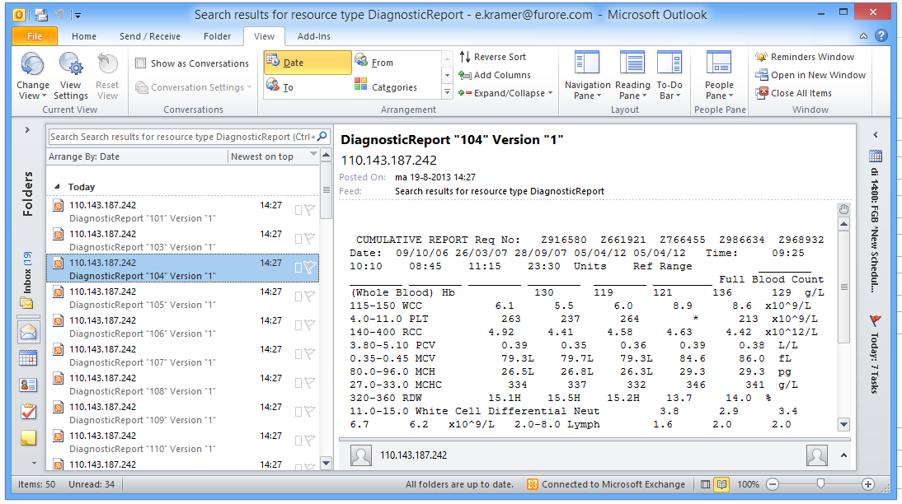
New reports in the mail

Slide 112
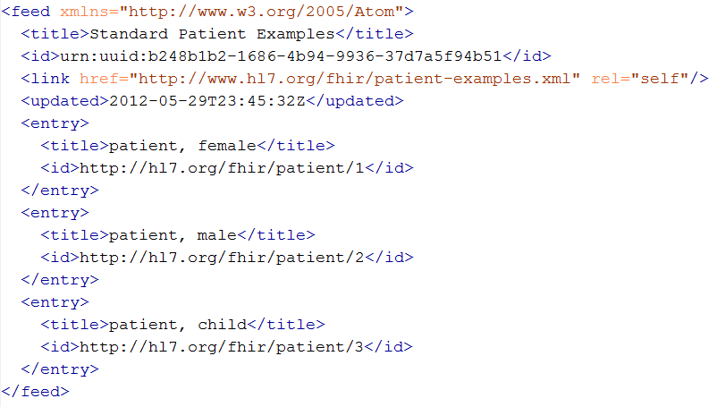
An example Bundle
1
2
2
2
Notes:
Note that the id of the resource is kept outside the resource itself
Atom has many other meta-data items (not shown), which we will discuss later.

Slide 113
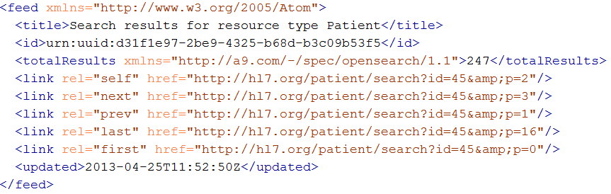
The feed header
Feed is simple:
“title” [1..1]: anything that tells humans what they’re looking at
“updated” [1..1]: the time (instant!) you composed the bundle
“id” [1..1]: a random, one-time id for this bundle
“link” [0..*]: page through the full results
“totalResults” [0..1]: number of total results
Notes:
Note that we use the ultra-new (sept 2012) Tombstones RFC, which is not yet supported by all platforms.
Remember, all updated timestamps in FHIR (type: ‘instant’) are precise to at least the second and ALLWAYS carry a timezone!

Slide 114
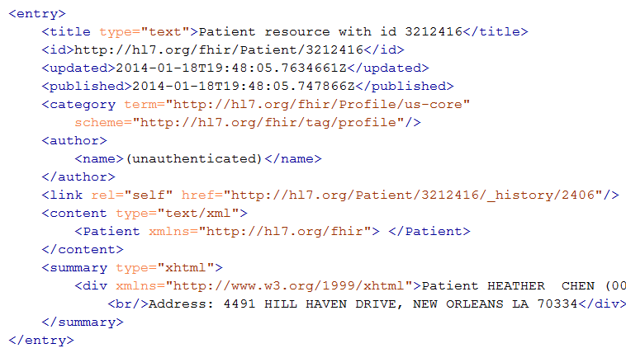
Resource Entry
Resource id
Last modified
Tags
Version-specific id
Resource content
Human-readable form,
just like Resource.text
Notes:
See how the resource meta-data is mapped to equivalent Atom members
Author is required by atom, so you’ll have to keep track who authored the resource, which might well be the user that POSTed it to your RESTful endpoint
Summary is optional, but it is easy to fill it with the Resource’s <text> (human readable narrative), so Feed readers have a way to display the contents of a resource. Yes, this means the summary is present twice in the entry.
All elements you see here are Atom spec, not FHIR

Slide 115
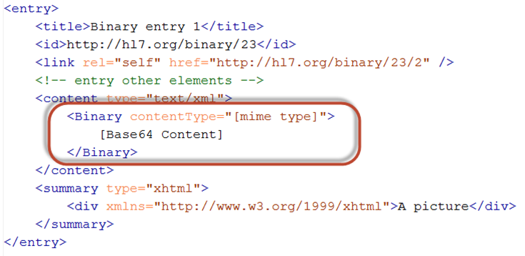
Binary Entry

Slide 116
Example: Keeping in sync
History of all resources on server
https://server.org/fhir/_history
History of all patient resources on server
https://server.org/fhir/Patient/_history
History of specific patient on server
https://server.org/fhir/Patient/1/_history
A history of all changes: updates and deletions, ordered by newest first
Limit with _since and _count

Slide 117
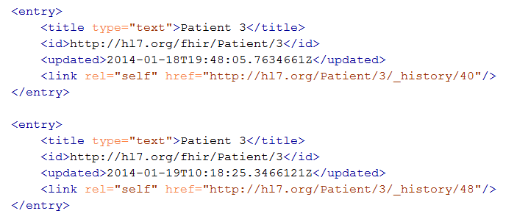
Multiple versions of entries
Same
id!
Notes:
Multiple versions are supported explicitly by Atom by having mutliple entries with the same id, but a different ‘updated’ date
Notice how the ‘self’ links do differ, these are different versions after all.

Slide 118
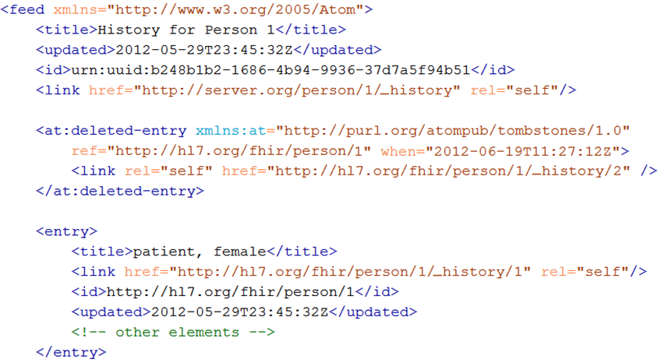
Atom Tombstones - Deletions
Notes:
Brand-new RFC, probably not much support in frameworks (yet).
Note the additional namespace
Updated Timestamp is still present, but is now called “when”.

Slide 119
Atom in JSON
There’s not yet a way to render Atom in JSON, though there are initiatives, all ugly.
So, we had to (sorry) roll our own….
…very straightforward, single-purpose
Atom JSON solution
(Note: MIME type is still application/json!)

Slide 120
Json Atom - Example
{
"title": "Search result",
"updated": "2012-09-20T12:04:45Z",
"id": "urn:uuid:50ea3e5e-b6a7-4f55-956c-caef491bbc08",
"link": [ { "rel": "self", "href": "http://server.org/fhir/Patient?format=json" } ],
"entry": [
{ "title": "Resource of type Patient, with id = 1 and version = 1",
"link": [ { "rel": "self", "href": "http://fhir.furore.com/fhir/Patient/1/_history/1" } ],
"id": "http://fhir.furore.com/fhir/Patient/1",
"updated": "2012-05-29T23:45:32Z",
"published": "2012-09-20T12:04:47Z",
"author": [ { "name": "Grahame Grieve / HL7 publishing committee" } ],
"content":
{ "Patient": { } }
}
]
}
Notes:
Just take a quick glimpse, it’s a pretty trivial translation of the Xml form to JSON, removing all needs for namespaces and attributes, and turning repeating elements into JSON arrays.

Slide 121
Bundles
For both Java and C#, reference has custom-built Atom parser
For .NET, you could use the framework’s SyndicationFeed
A bit more low-level
No support for deleted-entries (even parse problems)
Incompatible with WinRT (Win8 mobile apps)
Notes:
* You might wonder: Since bundles are Atom, why not use standard Atom parsers?

Slide 122
Identifiers in Bundles
Resources in a bundle will frequently need to reference each other
Absolute: https://example.org/fhir/Observation/1
Relative: Observation/1
(absolute will have a “:”, relative won’t)
Relative references must be made absolute using fhir-base
(mandatory for feeds with relative references)
<link rel="fhir-base" href="http://example.org/fhir"/>
Notes:
Around 4pm

Slide 123
Bundles in C#
Abstraction on top of Atom parser
Bundle = feed, BundleEntry = entry.
Bundle result = new Bundle() { Title = "Demo bundle" };
result.Entries.Add(new ResourceEntry<Patient>()
{ LastUpdated=DateTimeOffset.Now, Content = new Patient() });
result.Entries.Add(new DeletedEntry()
{ Id = new Uri("https://..."), When = DateTime.Now });
var bundleXml = FhirSerializer.SerializeBundleToXml(result);

Slide 124
Bundles in Java
AtomFeed feed = new AtomFeed();
feed.setTitle("Demo bundle");
AtomEntry pat = new AtomEntry();
pat.setUpdated(Calendar.getInstance());
pat.setResource(new Patient());
feed.getEntryList().add(pat);
AtomEntry del = new AtomEntry();
del.setUpdated(Calendar.getInstance());
del.setDeleted(true); del.setId("http://nu.nl/fhir");
feed.getEntryList().add(del);
ByteArrayOutputStream bos = new ByteArrayOutputStream();
AtomComposer comp = new AtomComposer();
comp.compose(bos, feed, true);
String xml = bos.toString("UTF8");

Slide 125
FHIR Documents
Characteristics
A point-in-time snapshot of information
Intended for persistence
Organize information for human consumption
Defined rules for how to render
Attested by a particular author
Do not (directly) drive behavior
May be clinical (e.g. CDA) or non-clinical (e.g. Structured Product Labeling)

Slide 126
Documents – are bundles
<feed>
<entry>
<Composition />
</entry>
<entry>
<Observation />
</entry>
<entry>
<Device />
</entry>
<entry>
<Prescription />
</entry>
<entry>
<Patient />
</entry>
</feed>
Composition Resource
Section
Metadata
Attester
Section
Observation Resource
Device Resource
Prescription Resource
Patient Resource
Notes:
A Document, no matter how nested, is flattened to a list of entries, the Document’s header being the first.
The document header (and any other the other resources) refer to each other using normal references to reflect the document’s nesting.
Of course, there may be a digital signature (on the whole Bundle) to attest to the content of the document.

Slide 127
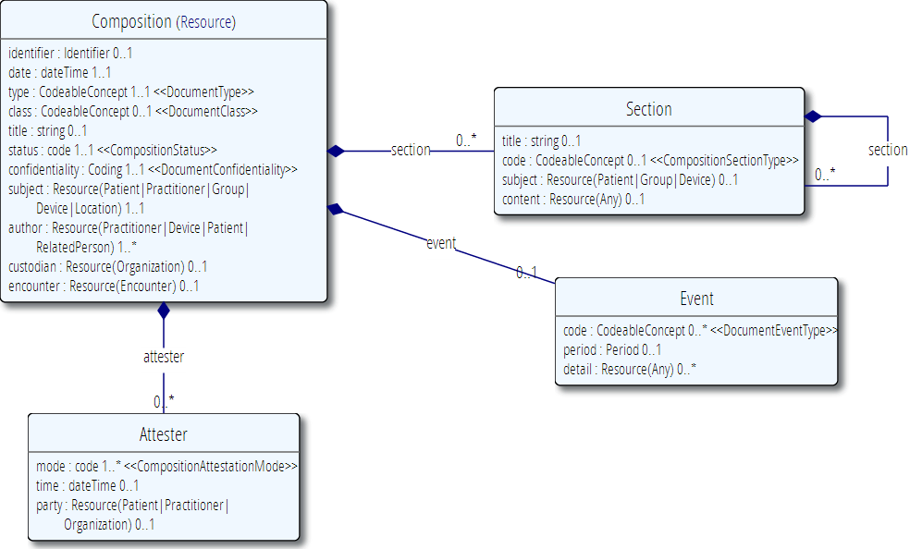
The Composition resource

Slide 128
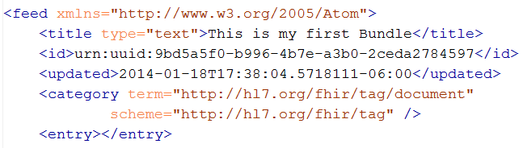
Tag as “Document”
This Bundle is a Document
Notes:
Why else might a bundle start with a Composition?

Slide 129
Communicating documents
You can “drop” your document using FHIR on
https://server.org/fhir/Mailbox
No storage or disassembly is implied, you are just posting a document in its entirety.
Servers can implement specific functionality as required between trading partners when receiving such a document.
Notes:
* But of course, some server could have functions to disassemble documents on reception. Since the contents of documents are resources, each of the contained resources (including the Composition) can be stored using the normal REST interface. But they are no longer the document anymore!

Slide 130
Communicating documents (cont’d)
You can store your document using
https://server.org/fhir/Document
Storage, NO disassembly is implied, document (and signature) stays intact
Search is supported (you search on it using Composition search criteria)
Notes:
* But of course, some server could have functions to disassemble documents on reception. Since the contents of documents are resources, each of the contained resources (including the Composition) can be stored using

Slide 131
Communicating documents (cont’d)
Documents can be passed around using the Binary resource
https://server.org/fhir/Binary
Storage, NO disassembly is implied, document (and signature) stays intact
Search is supported, but only by id
Useful for referencing a document as a resource

Slide 132
Communicating documents (cont’d)
Documents can be sent to a server’s “root” URI for processing as a transaction
https://server.org/fhir
Each resource is processed separately
Document id and signature is lost
Can theoretically re-assemble by retracing from the Composition resource

Slide 133
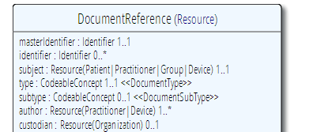
(XDS) references
A document reference resource is used to describe a document that is made available to a healthcare system.
DocumentReference and DocumentManifest Resources are used in document indexing systems, and are used to refer to:
CDA documents in FHIR systems
FHIR documents stored elsewhere (i.e. registry/repository following the XDS model)
PDF documents, and even digital records of faxes where sufficient information is available
Other kinds of documents, such as records of prescriptions.

Slide 134
IHE MHD
“This winter (…) the Volume 2 part of Mobile Health Documents (MHD) will be replaced with the appropriate content describing a profile of DocumentReference to meet the needs of MHD and the family of Document Sharing in XDS, XDR, and XCA.”
John Moehrke, august 16, 2013

Slide 135
FHIR Messages
Messages are collections of resources sent with the intention of driving some sort of action
often replied to with another message
Not intended for persistence as a whole
Always tied to some sort of “event”
Specific originator and intended recipient
Same as v2 and v3 message model

Slide 136
Messages – are bundles
<feed>
<entry>
<MessageHeader />
</entry>
<entry>
<Observation />
</entry>
<entry>
<Patient />
</entry>
<entry>
<Device />
</entry>
</feed>
MessageHeader Resource
source
destination
event
Observation Resource
Device Resource
Patient Resource
Notes:
A Message is similar, refers (amongst others) to its author, and contains information about the source, destination and the event that triggered it.
A message contains 1 “data” resource, which is the root of the payload of the message. This is just a normal resource, which in its turn can refer to other related resources.

Slide 137
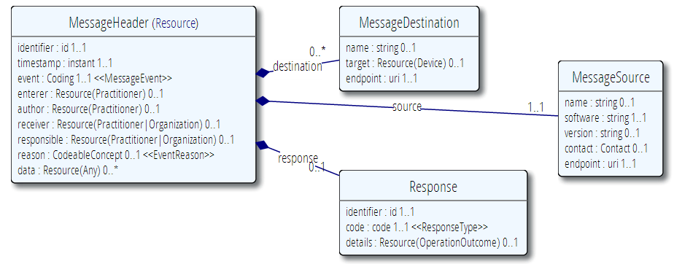
MessageHeader Resource

Slide 138
FHIR messages
No storage of the “MessageHeader” resource implied. Might be used in a router, converted to v2, etc.
The server can process them based on the event code and return the response as another message (again a bundle).
Notes:
* It’s the same drop-off point as for documents!

Slide 139
Communicating messages
No REST necessary, you can send FHIR Messages over mail, MLLP, TCP, or even REST ;-)
FHIR defines an HTTP end-point for messages
https://server.org/fhir/Mailbox
Response comes back in the acknowledgment payload

Slide 140
Exercise #4
Make a document . . .
(40 minutes)

Slide 141
Create a Document
Create a Document for your Patient and submit it to the Document end-point
Should have at least 3 sections
At least two of the resources should point to each other
Bonus points
Send the document as a Transaction
Create the same document in the other syntax (JSON/XML)
Do it by hand – don’t just download converted version from the server
Super bonus points
Hand-calculate the digital signature ☺

Slide 142
Exercise Review
Who remembered to declare the document tag on the feed?

Slide 143
Take-away
My take-away for “FHIR Bundles” is . . .
Notes:
Most useful thing you learned? What you need to watch out for in your implementation? What you want to investigate further?

Slide 144

Discussion
Carry-over Questions?
Notes:
Graphic: scraped knee?

Slide 145
Hands-on FHIR
Lloyd McKenzie
March 11-12, 2014
(Day 2)

Slide 146
Temperature Check
Too fast? Too slow?
Content at the right level?
Something you’re really hoping we’re going to get to today?
Questions that arose over bar conversations last night? (Preferably FHIR-related . . . ☺)

Slide 147

Review

Slide 148
Discussion
What paradigms would you use when?
Services
Messages
Documents
REST
Notes:
Graphic: scraped knee?

Slide 149
Querying FHIR
Searches, Queries, Partitions & Validation

Slide 150
Getting “all” patients
https://server.org/fhir/Patient
Always returns a paged feed
Use _count to indicate number of results per page
Special case of the “real” search operation: https://server.org/fhir/Patient/_search?name=eve

Slide 151
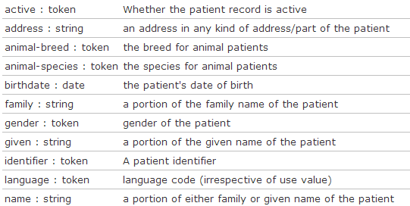
Search (patient)
Each resource has a set of “standard” search operations, so not every element can be searched!:
Our last search used this one

Slide 152
Combining parameters
Specifying multiple parameters finds resources matching all params ➔ “AND”
Parameters may list multiple values ➔ “OR”
Try:
https://server.org/fhir/Patient/_search?birthdate=1972-11-30&language=nl,fr

Slide 153

Search (patient)
Each search parameter has a ‘type’
Parameter
Type

Slide 154
Parameter types
number: =, =<, =<=, =>, =>=
Significant digits matter
date: =, =<, =<=, =>, =>=
Matches calculated using interval operations
Precision turns all dates into intervals
string: =
“contains” search, ignoring case, accents
Can use :exact to be case and accent-sensitive

Slide 155
Parameter types (cont’d)
token: =
[code] matches codes/identifier values independent of system
[system]|[code/value] matches a specified code or identifier within the specified system
|[code/value] matches the specified code or identifier in instances where no system is declared
:text performs a string search on CodeableConcept.text, Coding.display and Identifier.label

Slide 156
Parameter types (cont’d)
quantity: =, =<, =>, =<=, =>=
[comparator][number]|[system]|[code]
Follows rules for number + token together for value + units of quantity
reference: =
Either the local or absolute id
:type filters resource type

Slide 157
Ok I get it…or not?
https://server.org/fhir/Patient/_search 406 hits
https://server.org/fhir/Patient?gender=M 234 hits
https://server.org/fhir/Patient?gender=F 167 hits
Total: 234 + 167 = 401
https://server.org/fhir/Patient/_search 406 hits
https://server.org/fhir/Patient?gender=M 234 hits
https://server.org/fhir/Patient?gender=F 167 hits
https://server.org/fhir/Patient?gender:missing=true 5hits
Total: 234 + 167 + 5 = 406

Slide 158
Chained searches
Patient has a search for “name”.
Observation has a search for “subject” (the id of the Patient, Group or Device)
How do I find Observations for a patient, searching using his name?

Slide 159
2 queries in 1
You (as a client) don’t need to do separate operations, just one:
https://server.com/fhir/Observation/_search?
subject.name=jim
But note: this still only works on the predefined search parameters. You cannot just use any property of the resource.

Slide 160
More optimizations
Say we do:
https://fhir.com/fhir/Observation?date=2014-01-20
We get back: a Bundle with 0..* “Observations”
Now, usually, wouldn’t we want the Patient information too? => Need to do “N” queries for the Observation’s “subject”
Quicker:
?_include=Observation.subject
Returns both Observations + Patients

Slide 161
Composites
What if I want to find all groups with a characteristic of “eye color = green”
Group?characteristic=eye color&value=green
Result: instance with characteristics of “eye color=blue” and “favorite color=green”
Solution
Group:characteristic-value=eye color$green
(don’t forget to escape the blank . . .)
Notes:
Obviously not real codes

Slide 162
Extension parameters
Just as FHIR doesn’t define all possible data elements, we don’t all possible parameters
Extension search parameters defined using Profiles
Conformance Statements identify what extension parameters are supported and what they’re called

Slide 163
Sorting
Use _sort:asc or _sort:desc to control sort
E.g. Observation?_sort:asc=name&_sort:desc=date
Sorts observations of the same type together, newest first

Slide 164

Paging
Atom (via RFC 5005) defines a mechanism for paging through a feed
Keep in mind that paging can be tricky in a stateless environment
Result set can change
Don’t want to accidentally miss data when paging forward
Notes:
Consider adding a “most recent change timestamp” as part of the continuation so you can flag if changes impact result sets.

Slide 165
Summary
Some resources can be “big”
e.g. Patient with pictures & lots of contacts
10MB JSON result set is bad when you’re an Android app presenting a list of 100 patients for a clinician to scroll through
Solution: _summary=true strips a resource’s elements down to those most likely to be useful in a “list” view.

Slide 166
Partitions
Some system designs like to enforce security based on URL. For them
https://example.org/fhir/Patient/1/Observation
Is more useful than
https://example/fhir/Observation?subject=Patient/1
For that reason, FHIR allows partitioning by Patient or Practitioner for resources where that is appropriate

Slide 167
Query by Tag
FHIR provides the ability to tag resources to identify profiles, access constraints, workflow, etc.
(We’ll discuss this more later)
In addition to normal query parameters, it’s also possible to query by tags applied to the resource

Slide 168
Get vs. Post
Query parameters can be sent either as part of the URL using a GET or as an application/x-www-form-urlencoded payload on a post
Some technologies may prefer one over the other. As well, POST hides query parameters from URL logging, which may provide privacy protections in some environments.

Slide 169
Query interoperability
FHIR has a lot of query capability
However . . .
Almost all of it is optional
So how do you design a client when you have no clue what the server will support?
The more generic you want your client to be, the less you should rely on sophisticated server capabilities
Always check the response to see what parameters were actually used

Slide 170
Exercise #5
Answer some questions . . .
(30 minutes)

Slide 171
Answer FHIR questions
Summary of all male patient’s born between 1960 and 1980
All patients of Health Level Seven
Most recent weight measurement
Patient van de Heuvel’s blood glucose readings over 6.2mmol/L
All patients with a confirmed condition of Asthma
Average blood pressure over the past year for patient smith
Notes:
Todo: real queries

Slide 172
Take-away
My take-away for “Searching FHIR” is . . .
Notes:
Most useful thing you learned? What you need to watch out for in your implementation? What you want to investigate further?

Slide 173
Profiles and Conformance

Slide 174
The need for Profiles
Many different contexts in healthcare, but a single set of Resources
Need to be able to describe restrictions based on use and context
Allow for these usage statements to:
Authored in a structured manner
Published in a repository
Used as the basis for validation, code, report and UI generation.

Slide 175
The need for Profiles
Profiles can serve the same purpose as:
CDA templates & implementation guides
HL7 v2 “static” profiles
CIMI implementation guides
OpenEHR Archetypes & templates
Profiles aren’t mandatory for interoperability, but they improve the degree of it.
Profiles never change meaning of an instance

Slide 176

Profiling a resource
Demand that the identifier uses your national patient identifier
Limit names to just 1 (instead of 0..*)
Limit maritalStatus to another set of codes that extends the one from HL7 international
Add an extension to support “RaceCode”
Note: hardly any mandatory elements in the core spec!

Slide 177
Structured & published
A Profile is just a “normal” Resource
Any FHIR server could serve Profiles (just like Patients, Observations, etc…)
So, any FHIR server is a profile repository!
You can send a resource and the profile it conforms to in the same bundle
A resource is simply referred to by its URI:
e.g. https://hl7.org/fhir/Profile/iso-21090

Slide 178
Using profiles
When communicating a resource, you can indicate the profiles it conforms to.
A server might explicitly state it only accepts resources conforming to a certain profile (and verify!)
You can ask a FHIR server to validate a resource against a given profile
Notes:
Be cautious about relying on declared profiles – not all systems will declare, not all declarations will be right.

Slide 179



Who publishes?
http://www.hl7.org/fhir/Profile/iso-21090
http://www.hl7.nl/fhir/Profile/patient-nl
http://www.health4all.org/fhir/Profile/
Notes:
“Drive-by” or “bottom-up” operability: “Communicate first, standardize later”
First, business partners. Then, collaborations, communities. Maybe, finally, nation-wide
It’s a natural process that people will want to make it work first, then only coordinate what they really need to, and then realize they can broaden their approach to a community.
“Support”, of course top-down should still be possible! Maybe even a combi in the long-term

Slide 180
What’s in a profile?
Conformance
Metadata
Identifier
Name, Version
Publisher
Description, Code
Status
Date (of publication)
Search Parameter
Resource and Datatype Constraints
Resource (via Tag)
Extension
Extension in Resource instance
ValueSet
ValueSet

Slide 181
Scale / design
Make a profile with just extensions
Make a profile with just 1 resource + extensions on that resource
Make a profile that includes all constraints on resources and data types in a message or document
Make a profile with all (say national) resources + extensions.

Slide 182
Profile metadata
Identifier: Universally unique identifier, assigned by author value=“urn:hl7.org:extensions:iso-21090“ or “2.16.840.1.113883.10.20.2.1”
Version: Version of the profile, manually maintained by author. Suggested format: a timestamp (e.g. 2013-01-01T12:34:45)
Name: Free natural text name (e.g. “ISO 21090 Data Type Extensions”)
Publisher: organization or individual responsible for publishing. Should be populated (e.g. “FHIR Project Team“)
Telecom: one or more contact points of the publisher (telephone, email, website etc,)
Description: longer description of the contents of the profile
Code: one or more coded descriptions to help with finding the profile
Status (fixed choice of draft, active, retired) + experimental Y/N
Requirements: scope & usage (the “need” or “why” of the profile)
Date (of publication), e.g. “2013-07-07"

Slide 183
Extensions
Accommodate those elements not supported by 80% of systems
Note - You’re not extending a resource per se, but you specify where an extension may occur:
A specific element within a resource (even root)
A specific element within a data type
All elements referencing a data type
All elements mapping to a specific mapping target
An extension

Slide 184

Extension definition
Note: multiple
contexts!

Slide 185
Must support?
Authors: SHALL be capable of providing a value for the element and resource
Consumers: SHALL be capable of extracting and doing something useful with the data element.
"Something useful" is context dependent. The Profile SHALL describe what it means for applications to “support” the element
Notes:
* Note: the spec *never* sets this to true, since it’s context dependent.

Slide 186
Extending a name
Key = location of formal definition
Value = value according to definition

Slide 187

Extending an extension?

Slide 188
Constraints
Profiles contain “Structures”: a set of constraints on (nested) elements of a Resource or Datatype
You give each structure a “name”, so you can refer to it (e.g. from a Profile Tag)
You can make structures “internal”: local to the package for purpose of reuse
Datatype constraints are always done for reuse of constraints

Slide 189
Constraining cardinality
Limit cardinality to 1..2
(e.g. to at maximum your organizations’ identifier + the national one)
1..2
1..1
0..0
Limit names to just 1 (instead of 0..*)
Forbid any telecom elements
Note: something that’s mandatory in the core definition cannot be made optional in a profile

Slide 190
Limit value domains
If deceased is given, it must be a dateTime, not a boolean
AddressNL
Use a profiled datatype (from this or other profile)
OrganizationNL
=“true”
Only allow reference to a profiled resource
Only allow “active” Patients

Slide 191
Contextualize narrative
Override the base spec’s descriptions by adding context specific narrative:
short : string 1..1
formal : string 1..1
comments : string 0..1
requirements : string 0..1
synonym : string 0..*
example[x] : 0..1 (example value!)
mappings : 0..* (more specific mappings)

Slide 192
Profiling bindings
Depending on “core” spec, you can:
“fixed”: not specify a different binding
“incomplete”: specify a different binding if needed
“example”: very likely specify a different binding
Change the bindings as specified in core:
Define a new ValueSet
Allow additional codes, Restrict to a subset
Specify whether implementers of your profile can deviate from your valueset.

Slide 193
Conformance levels
If implementers of your profile choose to have different codes:
 | IsExtensible “N” | IsExtensible “Y”
Required “SHALL” | Validation error, non-conformant | Additional codes allowed
Preferred “SHOULD” “Guidance” | Validation warning, discouraged | Supplemental codes likely Alternatives allowed
Example “MAY” | Just a suggestion, no preference

Slide 194
ValueSets
A “true” FHIR ValueSet resource (may be version specific)
A general reference to some web content that defines a set of codes. (e.g. mime types).
A textual description of the possible codes

Slide 195

Publication meta-data
Concepts from 1 or more existing systems
Additional concepts

Slide 196
Add formal constraints
Invariants, co-occurrence
Uses free text (human) + xpath (executable)
Constraints should be declared on lowest element in the hierarchy that is common to all nodes referenced by the constraint.
Identified by (local) id, involved elements refer to that id
Specify severity (“error” or “warning”)

Slide 197
Slicing
Schematic view of Composition (aka a Document header)
Composition
type: CodeableConcept
Section
code: CodeableConcept
content: Resource(Any) 0..1
0..*
Slicing = constraining a repeating element
Base Composition has 0..* “Sections”
Section has 0..1 element with content

Slide 198
Slicing into a CCD
Composition
type = “34133-9” “Summarization of
episode note”
Section
code = 42348-3 (“Advance directives”)
Section
code =11450-4 (“Problem list”)
…
Section
code = 18776-5 (“Treatment plan”)
“Slice” the repeating sections into a fixed set of profiled sections.
“code” is fixed and is called the discriminator

Slide 199
Aggregation
Aggregation: for each ResourceReference choose 1..3:
Code | Definition
contained | Reference to a contained resource.
referenced | Reference to to a resource that has to be resolved externally
..bundled | Reference points to will be found in the same bundle

Slide 200
Profiles at run-time
In addition to design-time constraints, profiles can be used at run-time
Load a profile to guide user-entry to meet a particular best practice guideline
Validate against a profile to determine whether an instance meets certain requirements (e.g. for decision-support)
Adjust data entry rules on-the-fly to reflect the constraints of a specified server

Slide 201

Forge
New (free) tool for editing FHIR Profiles
Undergoing Beta testing – should be released shortly
Demo?

Slide 202
Conformance
There’s a resource for documenting conformance to FHIR
Can be used for:
Stating how a specific system instance behaves
Defining how a software system is capable of behaving (including configuration options)
Identifying a desired set of behavior (e.g. RFP)
To declare themselves “FHIR Conformant”, a system must publish a Conformance instance

Slide 203
Remember versions??
Which wire formats supported?
Which resources?
What documents, messages does the server accept, what does the content look like?
Which protocols? http? Mllp? ftp?
Which operations (read, create, update, search)
Which FHIR version?
What search operations?
Is this a test server?
Who can I contact?
What’s the name of the software?
DO YOU SUPPORT HISTORY?
http://www.hl7.org/fhir/conformance.htm

Slide 204
How to get conformance
Conformance is again, just a Resource
Any FHIR server will publish his own conformance at a special endpoint
A FHIR server may store and publish any number of additional Conformance resources, so you can refer to them
Validatable by automated testing
Notes:
Conformance registry could be used for discovery of participants in a regional exchange, means of advertising system capability, etc.
No tools yet for authoring – volunteers?

Slide 205
Conformance at run-time
In theory, a client can auto-configure itself based on a declared conformance profile
What resources can be accessed, what data elements are used, etc.
Because the location for a system’s conformance statement is fixed, all you need is the base URI

Slide 206
Exercise #6
Make a profile &
a conformance statement . . .
(40 minutes)

Slide 207
Profile & Conformance Statement
Design a Profile for Blood Pressure
You decide how detailed/rigorous you want to be
Create a Conformance resource for a system you know well, converting the requirements to FHIR

Slide 208
Take-away
My take-away for “Profiles & Conformance” is . . .
Notes:
Most useful thing you learned? What you need to watch out for in your implementation? What you want to investigate further?

Slide 209
FHIR Implementation Considerations
Architecture, Design and Hidden ‘Gotchas’

Slide 210
Some possible uses
v3
App
v2
FHIR
PHR
FHIR
Broker
Comm.
Interface
FHIR
DB
Notes:
You’re a message broker routing and translating between v2, v3 and FHIR
Your app interfaces with a PHR using FHIR natively
Your application can communicate using FHIR, but your software uses a proprietary RDBMS
Use FHIR as the common language for a Vendor Neutral Archive
…Or a combination….
You might see data as a nested structure of XML, a series of tables with keys, class-diagrams….

Slide 211
Repository model
HIS
LIMS
PACS
SystemX
Gateway
FHIR
FHIR
FHIR
FHIR
FHIR
Vendor Neutral Repository

Slide 212
Overview of a server
HTTP / REST interface
Encoding/decoding, param validation, syntax validation
Implement service operations as described in spec
Fhir Service
Indexer / Search
Storage

Slide 213
From wire to store
REST interface
JSON/XML
JSON/XML
JSON/XML
FHIR Parser
FHIR Parser
FHIR Parser
Fhir Service
POCO/POJO
POCO/POJO
POCO/POJO
O-R Map
Serialize
Serialize
Storage
NoSql (Xml/Json)
DBMS
DBMS
Notes:
First scenario is most common for existing databases: you have to map the FHIR structure (as POCO’s) onto your (existing) databases tables. Lot’s of mappings to support our nesting, cardinalities, data types
Second scenario uses the parsers to create POCO’s then use a NoSql driver’s serialization possibilities to store the structure-as-is in NoSql
Third scenario uses POCO’s and DBMS, but instead of mapping FHIR to tables, stores the data as-is into blob storage in a DBMS

Slide 214
Briefest intro to JSON
JSON (“JavaScript Object Notation”): it’s JavaScript, not markup!
{ “Country" : { “name" : “the Netherlands", “population" : 16696000,
“popDensity” : 447.9
}
}
var report = eval(“({…})”); alert(report.LabReport.status);
Very easy parsing for JavaScript clients. But actually, use JSON.parse() instead ;-)

Slide 215
Xml and JSON are different
Xml
JSON
<XXX xmlns=“urn:foo”>
<B a=“c” />
<C>One</C>
<C>Two</C>
<D>One</D>
<div>Not <b>so</b> easy</div>
</XXX>
{ “B”: { “a” : “c” },
“C”: [ “One”, “Two” ],
“D” : “One”,
“div” : {
“text-before”:“Not ”,
b:“so”,
“tekst-after”:“easy”}
}
How to retain namespaces?
How do you identify attributes?
Bridge difference in data types?
Distinguish single elements from lists with one element?
Mixed content?
Notes:
We tried to find a way to automatically convert between the two so you could round-trip…
But discovered you’d need additional metadata to do that, or vendor-specific solutions
Decided not to introduce these: result was weird Xml or weird Json
Reference platform contains tools to interconvert (these use model definition metadata)

Slide 216


Xml and Json in FHIR
relationship.coding is 0..*
primitives

Slide 217
Handling both
You need “meta” knowledge of the definition to distinguish lists / attributes
The Java/C# API’s can easily interconvert
Digital Signatures (in json?) are a problem when converting → store the original
JAXB / XmlSerializer / DataContract would need extensive customization / additional @annotation / [attributes]. Contact us!

Slide 218
Document-oriented store
A document-oriented store can store Resources as a “whole” document.
E.g. MongoDb stores documents in JSON:
post = { author: “mike”,
text: “my blog post...”,
tags: [“mongodb”,“intro”] };
db.posts.save( post );
db.posts.find( { author: “mike” } );
db.posts.find().sort({date: -1}).limit(10);

Slide 219


Slide 220


No (sql) transactions

Slide 221
Batch: needs transactions
Transaction
The transaction interaction submits a set of resources to be updated, created or deleted on the server. This interaction allows multiple resources to be updated/created in a single transaction. The interaction is performed by an HTTP POST command as shown:
POST [service-url] (?_format=mimeType)
The content of the post submission is a resource bundle.

Slide 222
Storing resources
FHIR POCO Model
Mongo
Patient
Atom Entry
(stored json)
Resource
Binary
Observation
Amazon S3
Metadata
Binary
Original
(json or xml)
Notes:
You might have to keep the original (as you received it on the service interface), for attestation/digital signatures
Store the binaries in another location (e.g. Amazon S3, filesystem) and just keep the URL here.

Slide 223
RDBMS: BLOB + Index
Id | ResourceId | VersionId | LastUpdate | Contents
1 | 1 | 1 | 2012-12-19 | <Patient …>
2 | 1 | 2 | 2012-12-20 | <Patient …>
3 | 2 | 1 | 2012-12-20 | <Observation …>
Id | Param | Value | System
2 | Patient.Name | “Ewout”
2 | Patient.DoB | “1972-11-30”
3 | Obs.Code | “234332” | SNOMED
Separate tables for current and history?
Type | VersionIdHigh
Patient | 2
Lab | 3
Need to index only latest version!

Slide 224
Both implementations use a separately maintained index for search?
Yes, here’s why…

Slide 225

Predictable search
Each resource has a fixed set of search parameters:
Searched element
Parameter
Type

Slide 226
Types of parameters
integer | Search parameter must be a simple whole number.
string | Search parameter is a simple string, like a name part. Search is case-insensitive and accent-insensitive. May match just the start of a string.
text | Search parameter is on a long string. Used for text filter type search: it functions on searches within a body of text and may contain spaces to separate words. May match even if the separate words are found out of order.
date | Search for an exact match on a date (parameters look like 1956-05-27T12:34:12+04:00 or shorter)
token | Search parameter on a coded element or identifier. May be used to search through the text, displayname, code and code/codesystem (for codes) and label, system and key (for identifier).
reference | A pair of resource type and resource id, separated by "/". Matches when the resource reference resolves to a resource of the given type and id.
Note: you need to escape the query-string!!

Slide 227
Partial/combined match
The search parameter description shows that the match certainly isn’t always exact, and can even combine the contents of several elements:
Name / Type | Description
address : string | an address in any kind of address/part of the patient
family : string | a portion of the family name of the patient
given : string | a portion of the given name of the patient
name : string | a portion of either family or given name of the patient
phonetic : string | a portion of either family or given name using some kind of phonetic matching algorithm
telecom : string | the value in any kind of telecom details of the patient

Slide 228

Prepare your data!
Patient/_search? name=johan& name=grafin& telecom=5552004
“Groom” – prepare for searching

Slide 229

Validation

Slide 230
Validation
When receiving an XML resource
1. Validate using schema
2. Run schematrons
When receiving JSON
1. Parse the JSON
2. Serialize to XML
3. Validate using schema
4. Run schematrons

Slide 231


(Distributed) validation
App’s server
Store &
Validate
Country validation server
Validate
Profile X
Profile Y
Profile Y
Validate
Notes:
A server might defer validation to another server (because it doesn’t know the profile)
A server may fetch the “unknown” profile and validate it itself
There may be several servers sharing the work

Slide 232
Tagging a Resource
Patient
MRN 22234
“Ewout Kramer”
30-11-1972
Amsterdam
http://hl7.org/fhir/tag/security
http://hl7.org/fhir/v3/ActCode#TABOO
http://hl7.org/fhir/tag http://example.org/fhir/Status#Test
http://hl7.org/fhir/tag/profile http://hl7.org/fhir/Profile/us-core
“a claim that the Resource conforms to the profile identified in the term”

Slide 233
Why tags?
Tags allow assertions of information about a resource that don’t change the resource itself
I.e. they can’t break signatures
Appropriate for things like access controls, declaring profiles, managing workflows
E.g. “Has this result been reviewed?”

Slide 234

Operation Outcome
When something goes wrong….return the OperationOutcome Resource!
Notes:
Also for warning and information messages

Slide 235

The “Other” resource
Now, what if you have the need for a completely “new” resource?
…then add extensions for each element

Slide 236
Discussion
Implementation & Architecture questions?
Notes:
Graphic: scraped knee?

Slide 237
Take-away
My take-away for “FHIR Implementation Considerations” is . . .
Notes:
Most useful thing you learned? What you need to watch out for in your implementation? What you want to investigate further?

Slide 238
Implementing FHIR

Slide 239
Reference implementations
Contents
Model – classes generated from the spec
Parsers – Parsers generated from the spec
Serializers – Serializers generated from the spec
FhirClient
Validation (currently Java only)
Java – Everything on the downloads page
.NET – NuGet “FHIR”, or GitHub “fhir-net-api”

Slide 240

C# reference implementation
Download Csharp.zip from the Implementation page (source code + dll distribution):
Namespaces
Model – C# classes generated from the spec
Parsers – C# Parsers generated from the spec
Serializers – C# Serializers generated from the spec
Support
Client

Slide 241
A FHIR Resource in C#
public partial class Observation : Resource
{
// Codes that provide reliability information about an observation
public enum ObservationReliability {Ok, Ongoing, …}
// Codes identifying interpretations of observations
public enum ObservationInterpretation {N, A, L, H }
public CodeableConcept Name { get; set; }
public List<ObservationReferenceRangeComponent> ReferenceRange { get; set;}
public Code<Observation.ObservationReliability> Reliability { get; set; }
public ResourceReference Performer { get; set; }
}
Notes:
Enums are generated for coded types with required, fixed, valuesets
Nested classes are defined for each component in a Resource, all nested directly within the Resource
Cardinality > 1 => becomes a List<>
Cardinality 1 => Not expressed in model, but done in validation
All classes are partial so you can add code them in another code file (keeping generated+handcrafted code separate)

Slide 242

Object Model
[FhirResource("DiagnosticReport")]
public partial class DiagnosticReport : Resource
{
public Code<ObservationStatus> Status {…}
public Instant Issued {…}
public ResourceReference Subject {…}
public ResourceReference Performer {…}
public Identifier ReportId {… }
public
List<DiagnosticReportRequestDetailComponent> RequestDetail { …}
Notes:
Todo: update this

Slide 243


Primitives are not really primitive…

Slide 244
Parsing/Serializing using C#
ErrorList errors = new ErrorList();
// Create a file-based reader for Xml
XmlReader xr = XmlReader.Create(
new StreamReader(@"publish\observation-example.xml"));
// Parse the Observation from the stream
var obs = (Observation)FhirParser.ParseResource(xr, errors);
// Modify some fields of the observation
obs.Status = ObservationStatus.Amended;
obs.Value = new Quantity() { Value = 40, Units = "g" };
// Serialize the in-memory observation to Json
var jsonText = FhirSerializer.SerializeResourceToJson(obs);

Slide 245
Parsing/Serializing using Java
XmlParser xml = new XmlParser();
Observation obs = (Observation)xml.parse(new FileInputStream(“observation.xml"));
obs.setStatusSimple(ObservationStatus.amended);
Quantity newValue = new Quantity();
newValue.setValueSimple(new BigDecimal(40)); newValue.setUnitsSimple("g");
obs.setValue( newValue );
ByteArrayOutputStream bos = new ByteArrayOutputStream();
JsonComposer comp = new JsonComposer();
comp.compose(bos, obs, true);
String json = bos.toString("UTF8");

Slide 246
Bundles
For both Java and C#, reference has custom-built Atom parser
For .NET, you could use the framework’s SyndicationFeed
A bit more low-level
No support for deleted-entries (even parse problems)
Incompatible with WinRT (Win8 mobile apps)
Notes:
* You might wonder: Since bundles are Atom, why not use standard Atom parsers?

Slide 247
Bundles in C#
Abstraction on top of Atom parser
Bundle = feed, BundleEntry = entry.
Bundle result = new Bundle() { Title = "Demo bundle" };
result.Entries.Add(new ResourceEntry<Patient>()
{ LastUpdated=DateTimeOffset.Now, Content = new Patient() });
result.Entries.Add(new DeletedEntry()
{ Id = new Uri("http://..."), When = DateTime.Now });
var bundleXml = FhirSerializer.SerializeBundleToXml(result);

Slide 248
Bundles in Java
AtomFeed feed = new AtomFeed();
feed.setTitle("Demo bundle");
AtomEntry pat = new AtomEntry();
pat.setUpdated(Calendar.getInstance());
pat.setResource(new Patient());
feed.getEntryList().add(pat);
AtomEntry del = new AtomEntry();
del.setUpdated(Calendar.getInstance());
del.setDeleted(true); del.setId("http://nu.nl/fhir");
feed.getEntryList().add(del);
ByteArrayOutputStream bos = new ByteArrayOutputStream();
AtomComposer comp = new AtomComposer();
comp.compose(bos, feed, true);
String xml = bos.toString("UTF8");

Slide 249
Using FHIR Client in C#
var client = new FhirClient(
new Uri("https://fhir.com/svc/fhir"));
// NB: patient is a ResourceEntry<Patient>, // not a Patient
var patEntry = client.Read<Patient>("1");
var pat = patEntry.Resource;
pat.Name.Add(HumanName.ForFamily("Kramer")
.WithGiven("Ewout"));
client.Update<Patient>(patEntry);

Slide 250
Using FHIR Client in Java
FHIRClient client = new FHIRSimpleClient();
client.initialize("https://spark.furore.com/fhir");
AtomEntry<Patient> pe = client.read(Patient.class, "1");
Patient p = pe.getResource();
HumanName hn = new HumanName();
hn.getFamily().add(Factory.newString_("Kramer"));
hn.getGiven().add(Factory.newString_("Ewout"));
p.getName().add(hn);
client.update(Patient.class, p, "1");

Slide 251
Exercise #3
Using the FHIR
C# and Java API’s
(60 minutes)

Slide 252
Migration – v2
Already have an integration engine that supports translation between v2 and FHIR
Resources map to segments reasonably well
As always, the challenge with v2 mapping is the variability of v2 interfaces
“Common” mappings can be created, but they won’t be one size fits all
HL7 v2

Slide 253
Sample v2 mappings
Every Resource has v2 mappings specified, e.g.:
http://www.hl7.org/fhir/patient-mappings.htm#http://hl7.org/v2
Patient
identifier | PID-3
name | PID-5, PID-9
telecom | PID-13, PID-14, PID-40
gender | PID-8
birthDate | PID-7
deceased[x] | PID-30
address | PID-11
maritalStatus | PID-16

Slide 254

Migration – CDA
Made more complex by human-readable nature
Need to ensure text <-> entry linkages are retained
Will best be handled on a template by template basis
Likely start with important ones like C-CDA
Notes:
12:15
Text linkages not as important when not human-attested

Slide 255
Exercise #7
Write code . . .
(60 minutes)

Slide 256
Populate and Post a Resource using code
Leverage one of the 4 reference platforms and write code to populate and post a Patient resource instance
Up to you how many elements to fill in
Try sending the resource to Grahame’s server and verify success by querying on the website
Bonus points
Add code to update and query the history of the resource too

Slide 257
Take-away
My take-away for “FHIR Implementation” is . . .
Notes:
Most useful thing you learned? What you need to watch out for in your implementation? What you want to investigate further?

Slide 258
The end is near…
Notes:
Time: 10:00-35:00 (25 minutes)

Slide 259
Balloting plans
1st Draft Standard for Trial Use ballot (DSTU) Jan 2014
semi-stable platform for implementers while still allowing non-backward-compatible change for Normative version if implementation experience dictates
2nd DSTU targeted for publication Summer 2015
New resources, capabilities + profiles for CCDA
Normative likely some time in 2017
We want *lots* of implementation experience before committing to backward compatibility
Not everything will go normative at once

Slide 260
Is FHIR going to replace . . .
HL7 v2?, v3?, CDA?
FHIR has the potential to supplant all of the above, but that’s not going to happen soon
Sunk costs don’t get thrown out easily
All HL7 standards will be maintained as long as implementers require
Notes:
Mobile, social web, green field are most likely adopters, though significant interest from other quarters

Slide 261

Next Steps for you
Attend other FHIR tutorials
Developers, Profiles, Deep Dive
Read the spec: http://hl7.org/fhir
Comment in the discussion areas
Follow #FHIR on Twitter
Shape the specification:
Join the FHIR track at this WGM
Feedback – discussion, tracker, list server
Try implementing it
Come to a Connectathon!

Slide 262
Education opportunities
Attend a Working Group Meeting
Tutorials, Connectathons
May 8-14 Paris
October 2-9 Atlanta
Attend an Implementation Workshop
Intensive tutorials, hands-on
This week
July 13-15 DC
November 16-18 Dallas
FHIR Institute Webinars
April 20-24 (Covers Day 1 from this implementation workshop)

Slide 263






International HL7 FHIR Developer Days November 18-20, 2015 in Amsterdam
Education
14 tutorials
pick & choose
Connectathon
Meet fellow developers
Put FHIR to the test
Networking
FHIR experts and authors on hand
http://fhir.furore.com/devdays

Slide 264
Take-away
1-2 FHIR-related actions to initiate this week

Slide 265
QUESTIONS?
lmckenzie@gevityinc.com
Notes:
Don’t forget your evaluations!

